Slide 1


Slide 2
01
04
{{SECTION_1_NAME}}
{{SECTION_4_NAME}}
{{SECTION_1_PAGE}}
{{SECTION_4_PAGE}}
02
05
{{SECTION_2_NAME}}
{{SECTION_5_NAME}}
{{SECTION_2_PAGE}}
{{SECTION_5_PAGE}}
03
06
{{SECTION_3_NAME}}
{{SECTION_6_NAME}}
{{SECTION_3_PAGE}}
{{SECTION_6_PAGE}}
© 2019-2025 ONE THOUSAND

Slide 3
01
04
{{SECTION_1_NAME}}
{{SECTION_4_NAME}}
{{SECTION_1_PAGE}}
{{SECTION_4_PAGE}}
02
05
{{SECTION_2_NAME}}
{{SECTION_5_NAME}}
{{SECTION_2_PAGE}}
{{SECTION_5_PAGE}}
03
06
{{SECTION_3_NAME}}
{{SECTION_6_NAME}}
{{SECTION_3_PAGE}}
{{SECTION_6_PAGE}}
© 2019-2025 ONE THOUSAND

Slide 4
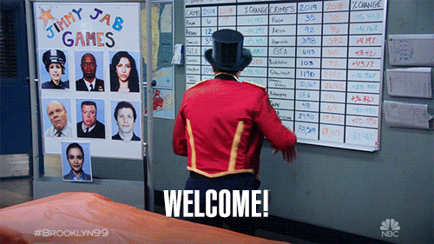
Before we start
© 2019-2025 ONE THOUSAND
Notes:
Capture the expecations on flipchart/ stickies and compare at the end

Slide 5
01
04
{{SECTION_1_NAME}}
{{SECTION_4_NAME}}
{{SECTION_1_PAGE}}
{{SECTION_4_PAGE}}
02
05
{{SECTION_2_NAME}}
{{SECTION_5_NAME}}
{{SECTION_2_PAGE}}
{{SECTION_5_PAGE}}
03
06
{{SECTION_3_NAME}}
{{SECTION_6_NAME}}
{{SECTION_3_PAGE}}
{{SECTION_6_PAGE}}
© 2019-2025 ONE THOUSAND

Slide 6

P
D
x
=
PAIN
DATA
© 2019-2025 ONE THOUSAND

Slide 7

© 2019-2025 ONE THOUSAND

Slide 8
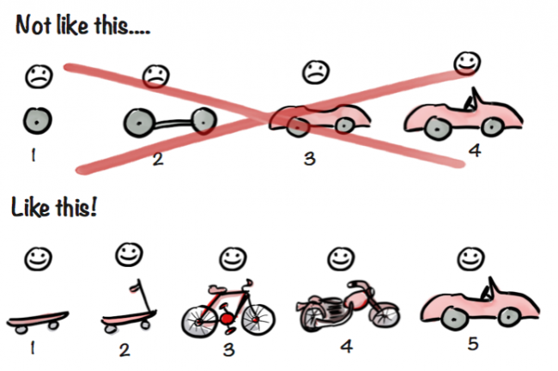

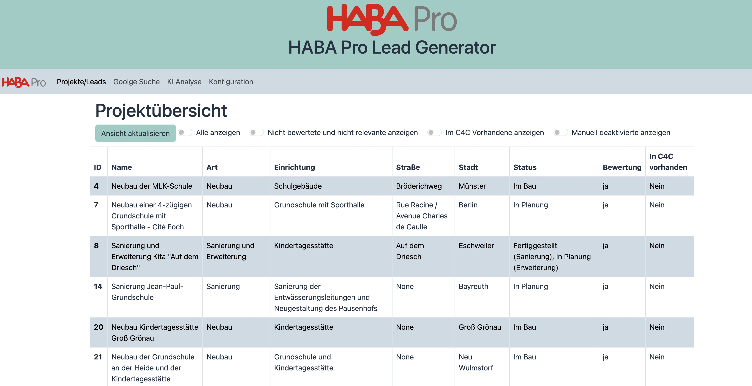
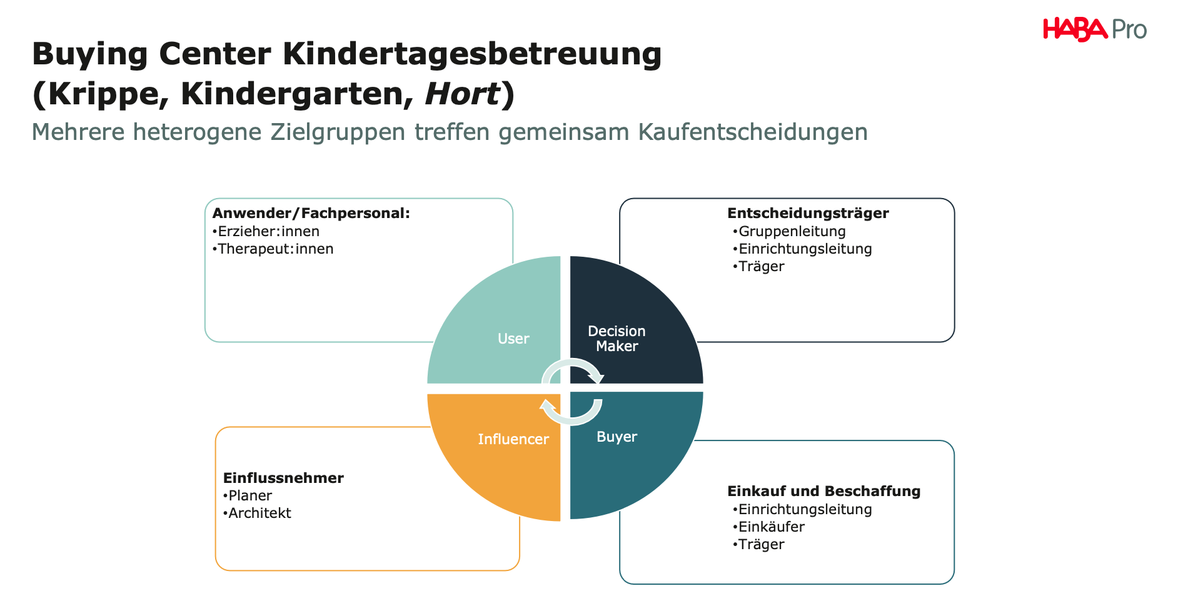
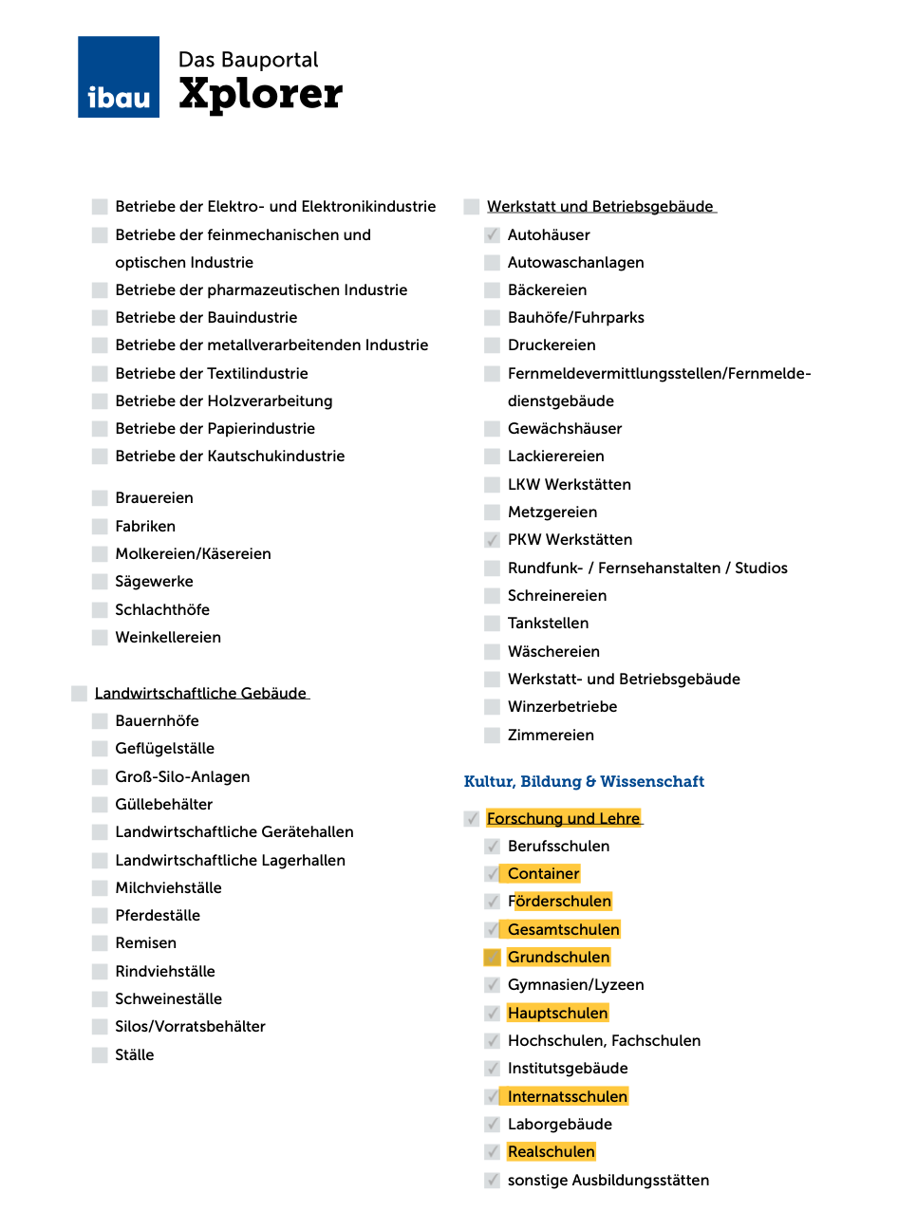
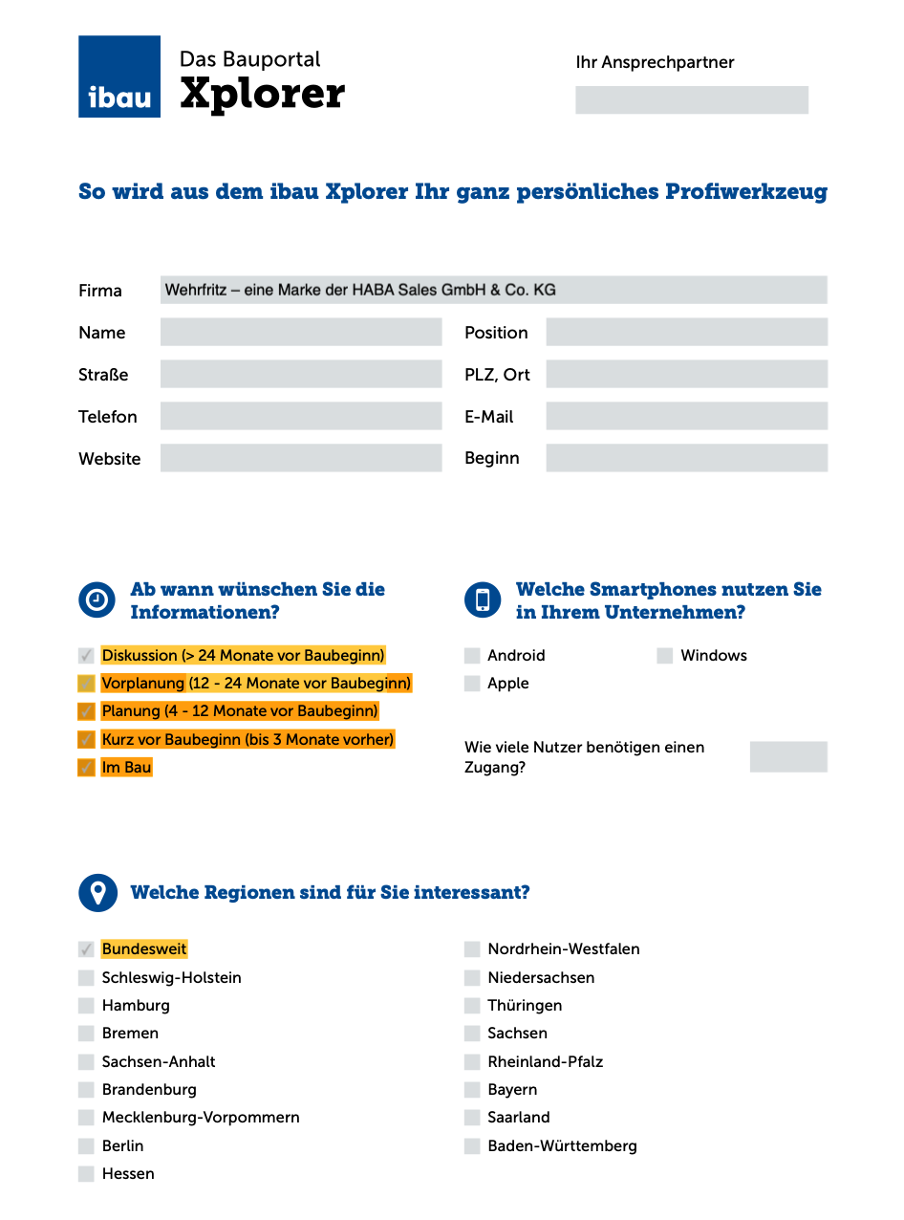
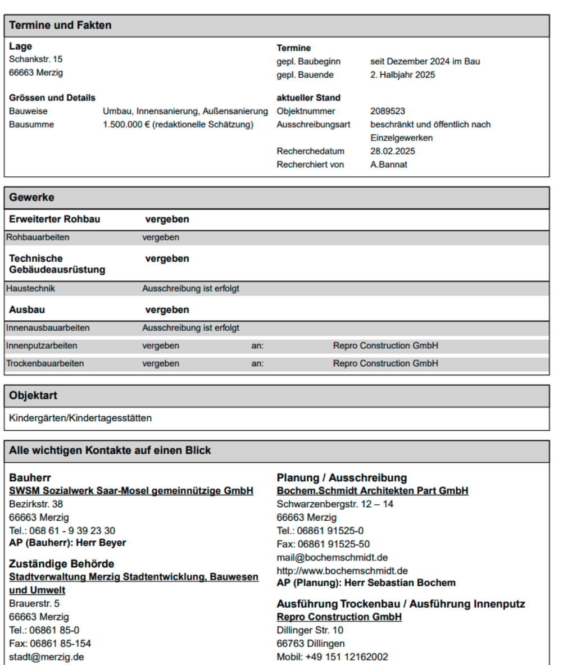
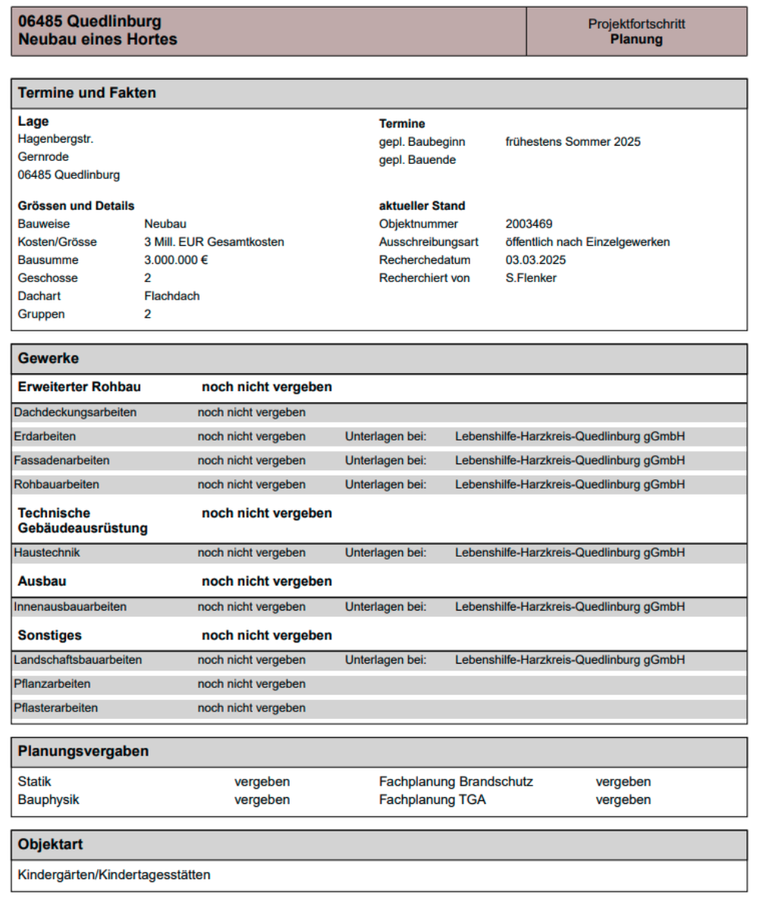
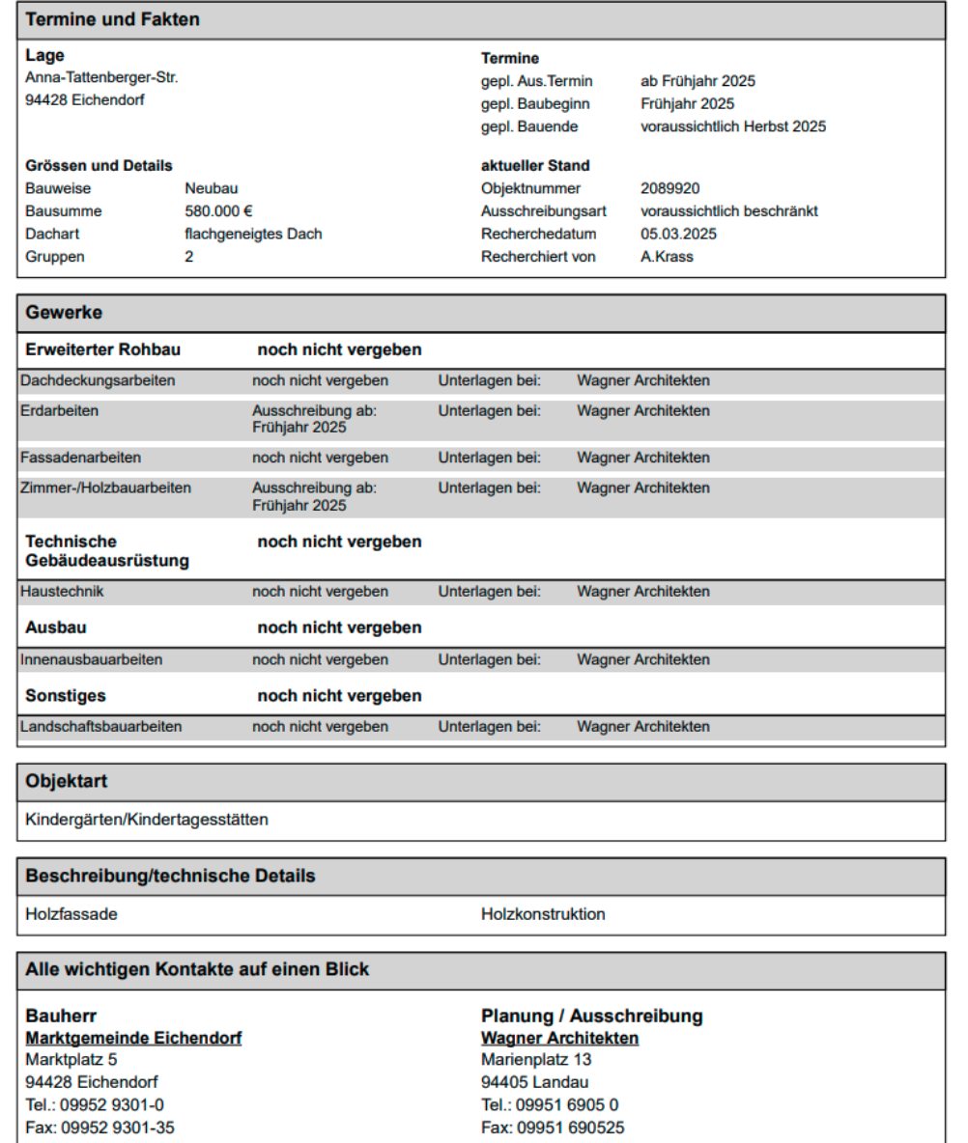
© 2019-2025 ONE THOUSAND

Slide 9
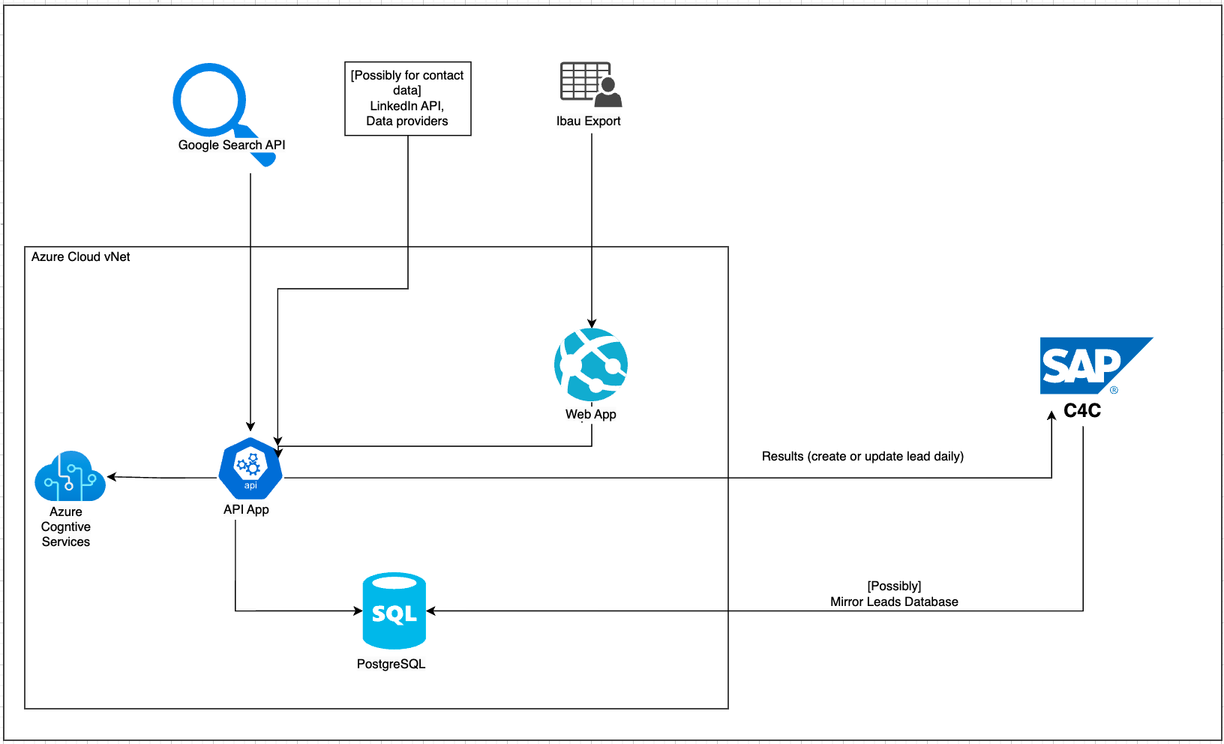
© 2019-2025 ONE THOUSAND

Slide 10
01
04
{{SECTION_1_NAME}}
{{SECTION_4_NAME}}
{{SECTION_1_PAGE}}
{{SECTION_4_PAGE}}
02
05
{{SECTION_2_NAME}}
{{SECTION_5_NAME}}
{{SECTION_2_PAGE}}
{{SECTION_5_PAGE}}
03
06
{{SECTION_3_NAME}}
{{SECTION_6_NAME}}
{{SECTION_3_PAGE}}
{{SECTION_6_PAGE}}
© 2019-2025 ONE THOUSAND

Slide 11
Sprint 1
Sprint 2
Sprint 3
Sprint 4
© 2019-2025 ONE THOUSAND
Notes:
Setup of the local LLM and associated technical services such as setting up the LLM chat and embedding endpoints, setting up the vector database, etc Goal:{same as above}
Preparation and integration of the data and fine tuning of the retrieval mechanism for the input data. - Goal: Model can answer specific questions from the data
{Description same as above}. Goal: Setup a pilot ready version and improvement in the answers
{Description same as above}. Goal: Extensive testing and improvement of the solution
Good as is.

Slide 12
© 2019-2025 ONE THOUSAND
Notes:
Sprint 1.5 Goals: Setup cloud infrastructure
Sprint 2: Datapipelines and Search Engine, minmal E2E
Sprint 3. UI and API, E2E finalised
Sprint 4.5: Access and security integration and stabilization
Testing:
Key users from customer service in Sprint 3

Slide 13
© 2019-2025 ONE THOUSAND

Slide 14
01
04
{{SECTION_1_NAME}}
{{SECTION_4_NAME}}
{{SECTION_1_PAGE}}
{{SECTION_4_PAGE}}
02
05
{{SECTION_2_NAME}}
{{SECTION_5_NAME}}
{{SECTION_2_PAGE}}
{{SECTION_5_PAGE}}
03
06
{{SECTION_3_NAME}}
{{SECTION_6_NAME}}
{{SECTION_3_PAGE}}
{{SECTION_6_PAGE}}
© 2019-2025 ONE THOUSAND

Slide 15
© 2019-2025 ONE THOUSAND

Slide 16
© 2019-2025 ONE THOUSAND

Slide 17
01
04
{{SECTION_1_NAME}}
{{SECTION_4_NAME}}
{{SECTION_1_PAGE}}
{{SECTION_4_PAGE}}
02
05
{{SECTION_2_NAME}}
{{SECTION_5_NAME}}
{{SECTION_2_PAGE}}
{{SECTION_5_PAGE}}
03
06
{{SECTION_3_NAME}}
{{SECTION_6_NAME}}
{{SECTION_3_PAGE}}
{{SECTION_6_PAGE}}
© 2019-2025 ONE THOUSAND

Slide 18

OTHER topics
DISCUSSION
From your perspective, are there any unresolved issues, critical topics, or concerns that need to be addressed?
Please feel free to raise them now so we can discuss and resolve them together.
© 2019-2025 ONE THOUSAND
Notes:
Should talk about release party

Slide 19
01
04
{{SECTION_1_NAME}}
{{SECTION_4_NAME}}
{{SECTION_1_PAGE}}
{{SECTION_4_PAGE}}
02
05
{{SECTION_2_NAME}}
{{SECTION_5_NAME}}
{{SECTION_2_PAGE}}
{{SECTION_5_PAGE}}
03
06
{{SECTION_3_NAME}}
{{SECTION_6_NAME}}
{{SECTION_3_PAGE}}
{{SECTION_6_PAGE}}
© 2019-2025 ONE THOUSAND

Slide 20


THANK YOU!!
How do you feel after the kick-off?

